Slide 1

DEPARTMENT OF ELECTRICAL AND ELECTRONICS ENGINEERING
18EEP109L – MAJOR PROJECT FINAL REVIEW
Digital Watermarking Of Audio Signals For Enhanced Signal Protection
Project by:-
Shruti Srivastava (RA1811005010271)
Gautam Nag (RA1811005010278)
Project guide :-
Dr. C. NAVEEN
Assistant Professor, Dept. of EEE

Slide 2
Abstract
In today's world we know the importance of encryption and privacy and with data being the most prized possession it is more important than ever to protect that data. Therefore for our project we are aiming at using this as our principal objective for protecting signal and audio during transmission.
To do this will use digital watermarking and using a digital image/unique code superimposing the signal and then transposing that image as a watermark on the audio signal.
Watermarking is a technique used to label digital media by hiding copyright or other information into the underlying data. The aim is to create a watermark that must be imperceptible or undetectable by the user and should be robust to attacks and other types of distortion. In our method, the watermark is kept as a digital image or if contingency arises a masked signal copy.
It is then weighted in the time domain to account for temporal masking. We discuss the detection of the watermark and assess the robustness of our watermarking approach to attacks and various signal manipulations.
We believe that doing so will uniquely enhance security of the audio signal.

Slide 3
Introduction
Audio watermarking is currently at the forefront of technology development to detect illegal reproduction and redistribution of audio recordings. Because the human auditory system (HAS) is more sensitive than the human visual system, audio watermarking is more challenging than visual watermarking.
A reliable digital audio watermarking shall have imperceptibility, data capacity, and robustness. The watermark must be inaudible within the host audio to maintain audio quality. The watermark data capacity is the information embedded or hidden in the host audio without perceptible distortion.
The watermark robustness is that the watermark must remain intact or identifiable through signal processing such as compression, time-scaling, filtering, and resampling performed on the watermarked audio.
Therefore for our project we have aimed at a way to protect an audio signal or audio file by encrypting it with a watermark which will ensure that each audio signal transmission and reception is protected from both ends of the communication.

Slide 4
Literature Review
To accomplish the targets of this research project on “DIGITAL WATERMARKING OF AUDIO SIGNALS FOR ENHANCED SIGNAL PROTECTION”, We have reviewed some literature papers to gain insights and to identify the gaps as it is the foremost and mandatory step to proceed with the research and to fulfill the requirement of the research. Having drawn inferences from the literature, I would like to summarize the points under this topic here for the audience to get a better understanding about this project as this topic is not much familiar and research in this field is in the growth phase.
Before going to the facts and understanding the methods that others opted for, let me explain to you in brief that adding a watermark to data is similar to installing a lock on entry of the house. The times have changed and with the times, the technology has also evolved and so have the crimes. Therefore to protect our assets our solution should also be advanced and this is what this topic speaks about the different ways that the researchers have developed to tackle the problem of stealing the data, manipulating it and redistributing it illegally by making pirate attacks to it.
With everything going digital post pandemic it therefore demands the security of data even more than before. One familiar solution or method that is available to us to solve this problem is “Steganography or Data Hiding” but as locks on the entry of houses do not provide 100 percent security this method also does not guarantee security cent percent. A research paper written by Ahmed H. Tew k and Khaled N. Hamdy discusses how they have generated a watermark by filtering a PN sequence with a filter that approximates the frequency masking characteristics of the human auditory system.

Slide 5
A Watermark is embedded into the digital signal at each point of distribution which is unnoticeable to the human eye. If the data is copied the watermark is carried with the data and the watermark can be retrieved from the copy and the source of distribution is known.
Digital Watermarking is a technology that embeds machine readable information within the content of a digital media file that could be image, audio or video.
The information is encoded through subtle changes to the image, audio, or video. In other words the watermarking is a practice of modifying the digital data( software program, photos, songs, videos) without causing destruction to it to embed a message about that work. Multimedia watermarking is the practice of imperceptibly altering a work.
The watermarking is a technique related to steganography which means keeping the existence of messages secret by hiding them within objects, media, or other messages.
***
There are two types of digital watermarking- visible and invisible. The visible watermark is similar to the corporation logo displayed at its letterhead but the invisible one that is embedded in the media is unnoticeable and undetectable to the human eye.
There are some six types of watermarks-
visible, non-visible, private, public, perceptual and bit stream. This is a blind watermarking technique that meets the requirements of invisibility and robustness.
Watermarking is performed by embedding a watermark in the middle-frequency coefficient block of three DWT levels. The PNN is used during watermark extraction.

Slide 6
Methodology
We started with the classification of the audio signal and dividing it by parameters such as their bandwidth, nominal level, power level in decibels (dB), and voltage level. The relationship between power and voltage is determined by the impedance of the signal path. Signal paths may be single-ended or balanced.
After analysis some research papers we found that audio signals have somewhat standardized levels depending on the application. Outputs of professional mixing consoles are most commonly at line level. Consumer audio equipment will also output at a lower line level. Microphones generally output at an even lower level, commonly referred to as mic level. For our project we will focus on the line level.
For our work we will be using MATLAB and Audacity which is an open source - multi platform software. This is an inhouse project for which the minimum specifications required to run the project are as follows: a. OS - Windows 7 and Above b. Processing power - 1.8GHz minimum c. RAM - 2GB and above

Slide 7
Quality Of Service Method of Execution
The QoS is known as the quality of services and refers to any technology that deals with data transmission. It is in place to reduce the packet loss, jitters and latency on the network. There are priorities in place that every transmission must follow to abide by these protocols. As applications such as phone, video, and time-sensitive data transit a network, enterprise networks must deliver predictable and quantifiable services.
QoS is utilized by organizations to fulfill the traffic requirements of sensitive applications like real-time voice and video, as well as to minimize quality deterioration caused by packet loss, delay, and jitter as mentioned before.
We used a similar software called Audacity to replicate the same and to find out for ourselves whether the theoretical flaws we found were practical or not.
For our audio we used a 1 minute clip from the audiobook called “The Adventures Of Sherlock Holmes”. This is an open source audio book available for sampling and free using. We added that audio file as a mono stereo file as tract one. Then we generated a secondary white noise and added it into track two (just below the previous track). Then we generate a tone (from the software) and superimpose it on the original audio file. In audacity we can basically change every single parameter of an audio file. For our sampling test we changed it to the following settings:

Slide 8
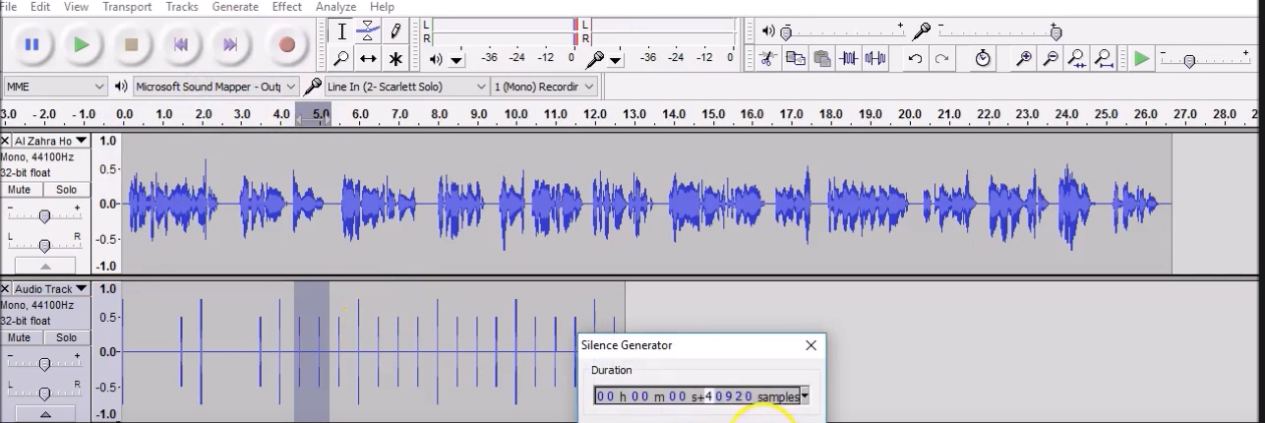
Parameter Name | Value Set
Audio Type | MP3 or WAV
Audio Channel | Mono
Frequency | 44100 Hz
Bit point (floating) | 32 bit
Mapping (range) | - 1.0 - 1.0
Time Sampled | Duration = 60 seconds

Slide 9
We then generated the traditionally encrypted audio signal and studied its pros and cons. We believe that encrypting an audio file like this has several advantages and disadvantages. But in the domain of encrypting an audio signal the disadvantages top the advantages.
Some of the disadvantages are which are:
The original audio signal will be susceptible to noise.
Anyone with the audio file can easily see the tune used to encrypt the file and remove it using a mediocre level software.
The sender has almost no control over the encryption.
The raw audio signal gets quite messy to discern the original content of the file
Therefore with these crucial disadvantages we proceeded to test it with another method to see if this method actually be improved upon and whether digital watermarking is actually needed.
From the first method we saw that one of the major disadvantages was that “A TONE” was being used as the overlapping signal. This in turn generated noise that made the original audio quality bad. However what if we used a single waveform rather than a whole tone. We used Audacity as before to do the same. We kept our original audio the same but changed the overlapping signal from a tone to a single waveform. We did this with 4 separated waveforms (sine, square, sawtooth and triangle).
Firstly we used a sine wave (400Hz, 1.0 Amplitude). From this we find that even though the raw audio file ended up retaining its original audio quality it showed no improvement in terms of encrypting the audio. All the open loopholes that were present when using tone overlapping are still present when using a waveform overlapping. The same result was seen while using square waveform, sawtooth waveform, triangle.

Slide 10
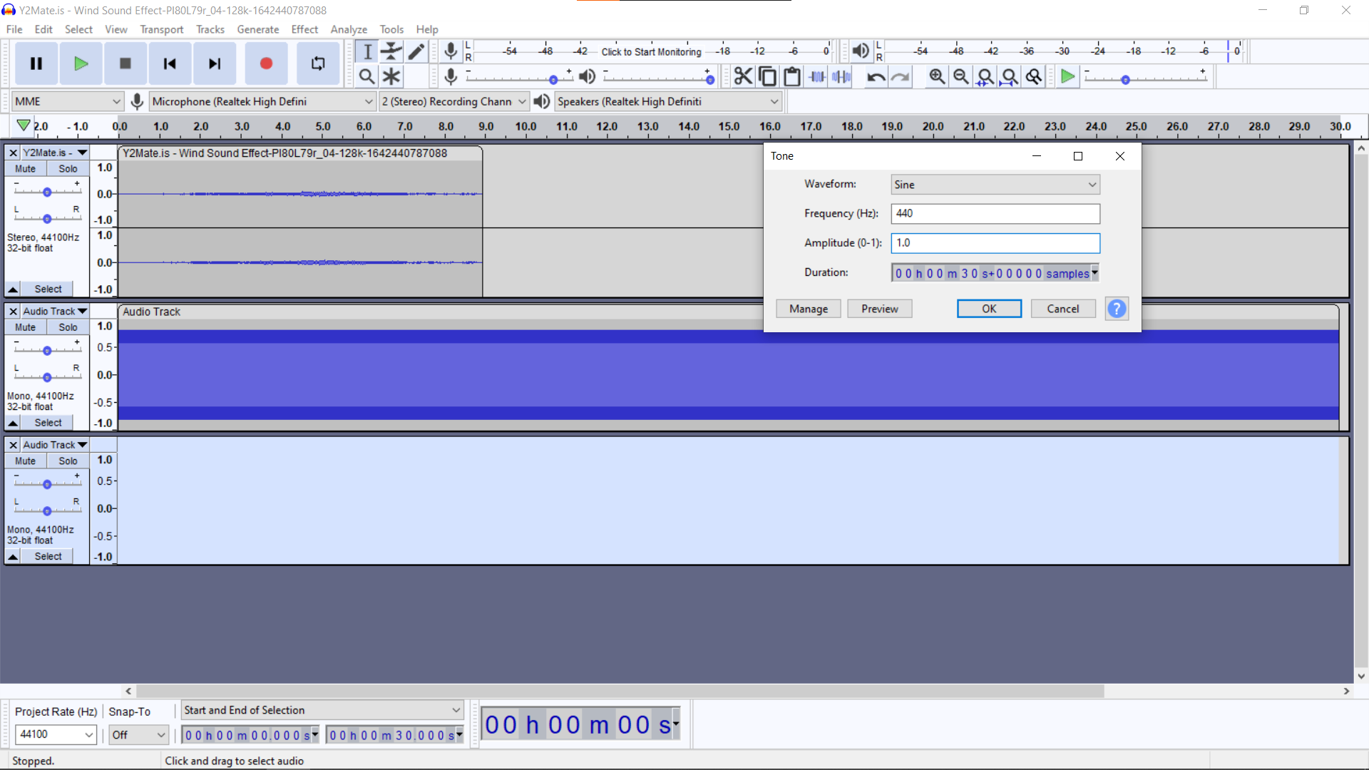
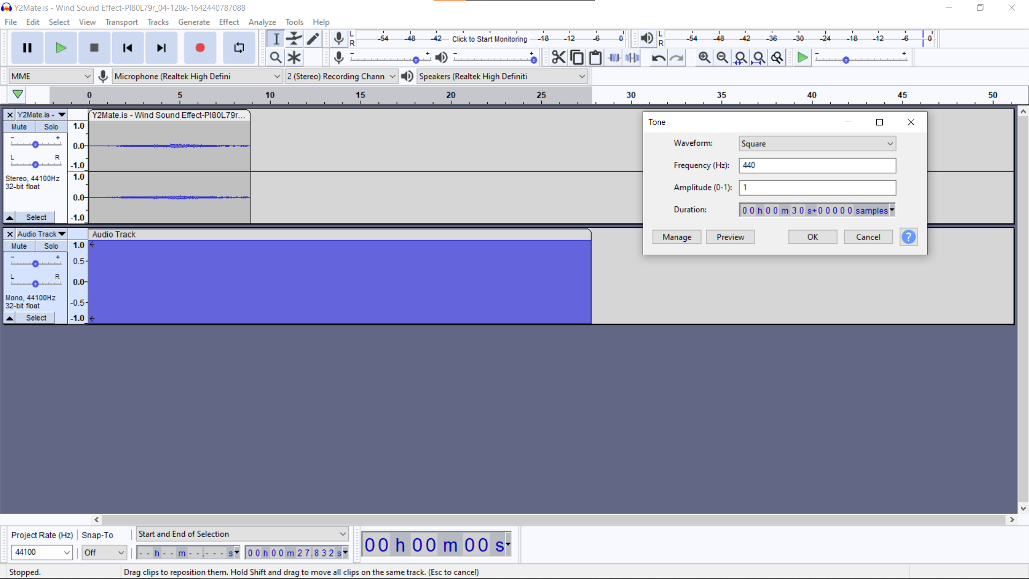
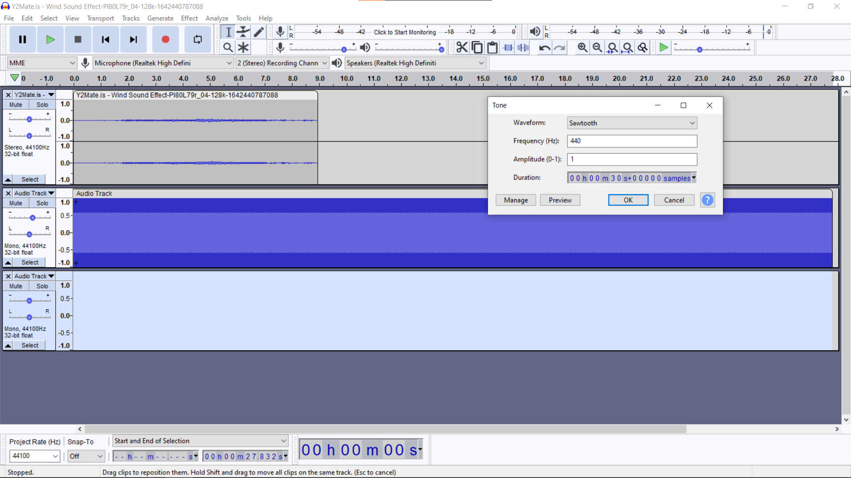
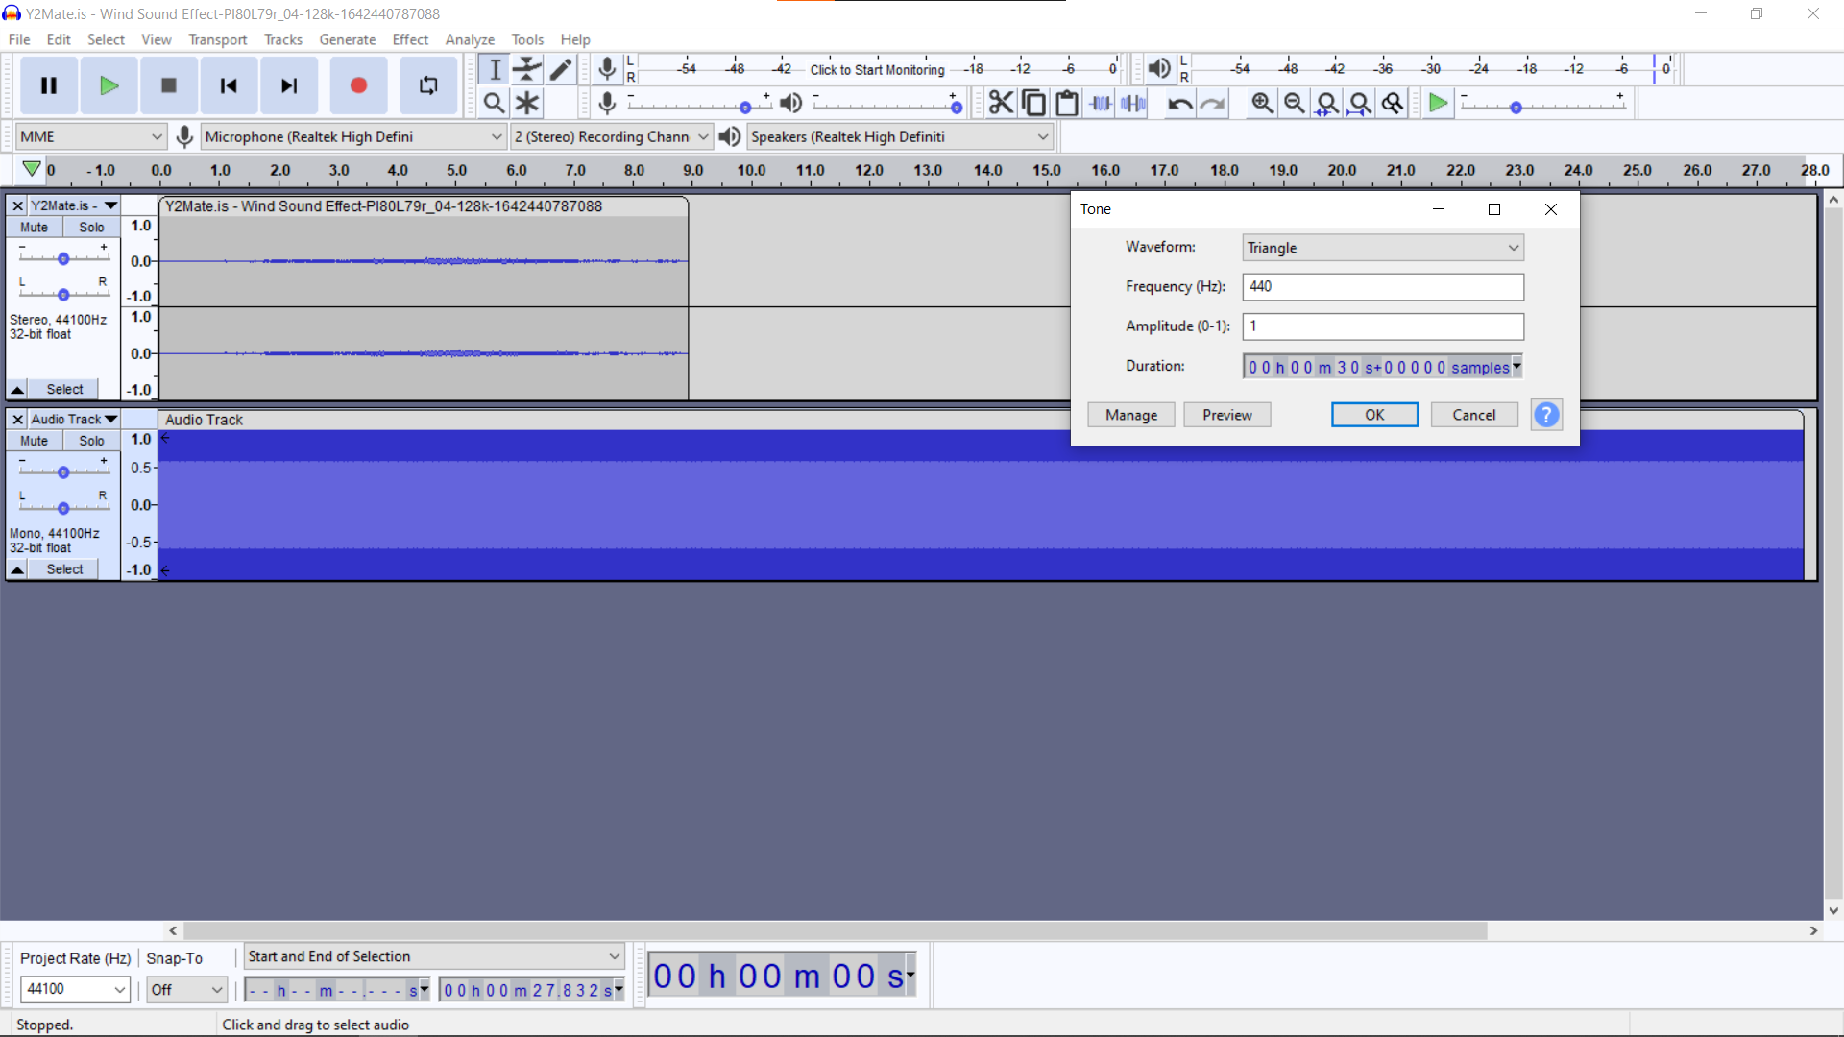
Sine
Square
Sawtooth
Triangle

Slide 11
Algorithm Analysis
Psychoacoustics - Masking Effects
A “weak” sound is difficult to be heard while a “strong” sound is also being played.
Temporal Masking - Amplitude (Volume)
Frequency Masking - Amplitude in Frequency
Image parameters - width="370" height="270“.
DC Watermarking
DC Watermarking puts the information into the part of music, where the magnitude is lower than the perceptual threshold of human ears.
Frequency Watermarking
For Frequency Watermarking, since human ear has limit on distinguishing audio frequency, it is possible to find out a frequency band loud enough while the frequency near it are rather quiet. Therefore, we replace the frequency band with low magnitude to our information to make the watermark.
Process
We implemented Frequency Watermarking in this project to achieve our goal.
The original soundtrack we used in this project is:
Length: 30 seconds
Sampling Rate: 44100 (1/s)
Frame Length: 512 samples

Slide 12
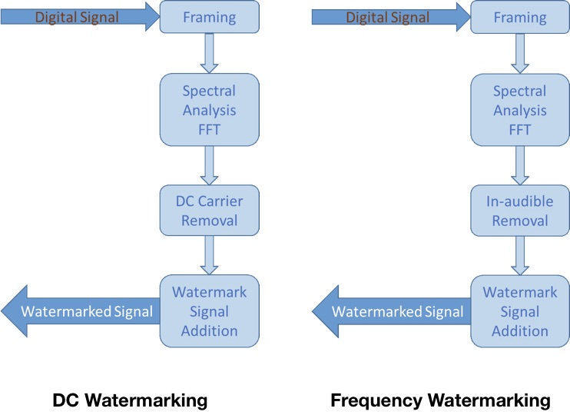

Slide 13
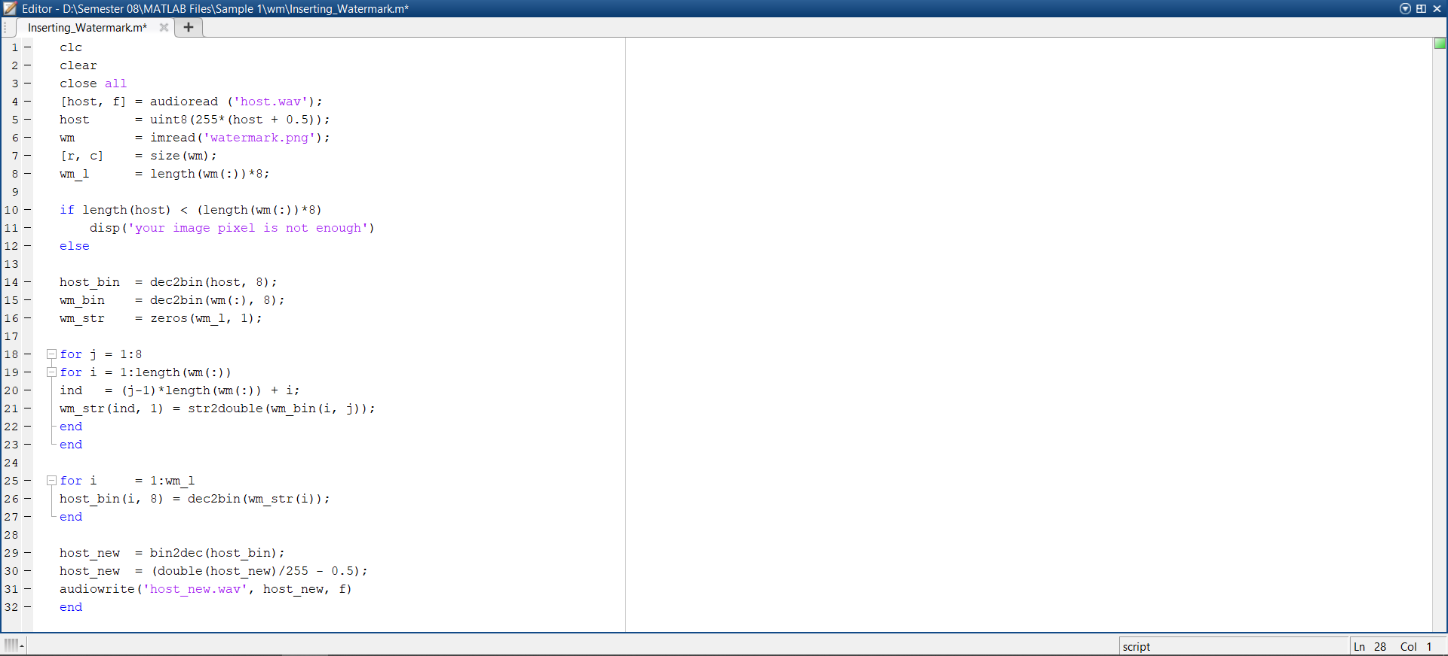
Code Snippet (Watermark Embedding)

Slide 14
Working (Watermark Embedding)
First of all we run a command to clear all the previous system clutter(memory) and get a clean command window.
Then we use the “audioread” command to load the host audio and store it in a variable with its address stored into an index variable (which in our code is named as f).
Then we load the watermark image (which is a png) into a using the “imread” command and store it is a variable named “wm”
Then we use a 2D array to store the dimensions of the image we are using as a watermark.
Then we use a conditional statement to check if the length of the host file is less than the length of the watermark * 8.
If it is then we reject that image as a watermark and display a message saying to use a different watermark.
Then we call the predefined MATLAB function called “dec2bin” to start the binary host.
Then we write the code to prepare the watermark:
Firstly we call the dec2bin function used just above this function.
Then we declare a n X 8 zeroes matrix (where n in the proportional row size of the watermark).
Then we run a for loop to insert a watermark into the first plane of the host signal.
Then for every iteration of the for loop declare the LSB by using the command “host_bin(i, 8) = dec2bin(wm_str(i))”
Finally host the watermark using the bin2dec() function and specify the data type as “double”.
End the code block.
Save the host code.
RUN the code to insert the watermark.

Slide 15
Algorithm Analysis Contd…
Therefore after analyzing the previous outputs and studying their disadvantages we see that using digital watermarking of audio signals for enhanced signal protection is indeed one of the most convenient ways to go about the problem statement of audio encryption.
Algorithm:
Clear memory and command window
Load data
Watermarking
Prepare host
Prepare watermark
Insert watermark into host
Watermarked host
Save the watermarked host

Slide 16
Working (Watermark Extraction)
First of all we run a command to clear all the previous system clutter(memory) and get a clean command window.
Specify an upper range for the watermark size and store it in a variable.
Divide that with 8 to get the number of pixels used in generating the size.
Store the image size in a variable as the square root of the pixel size.
Call the “audioread” function and pass the path of the watermarked host signal’s path name into the function.
Use the double [-0.5 +0.5] to 'uint8' [0 255] parameter to match the watermark dimensions matched to the double data type.
Define the host bin size at (1:max size) and store it in a variable.
Call the “reshape function” and pass the above variable along with the pixel size and the constant number 8(that we used to divide in step 2 into the function.
Define a zeros matrix.
Run a for loop on this matrix:
For every iteration of the for loop use the bin2dec to generate a LSB and store it in a variable.
End the for loop.
Call the reshape function used before and replace the constant 8 with the image size variable.
Call in the imshow() function to finally extract and display the watermark.

Slide 17
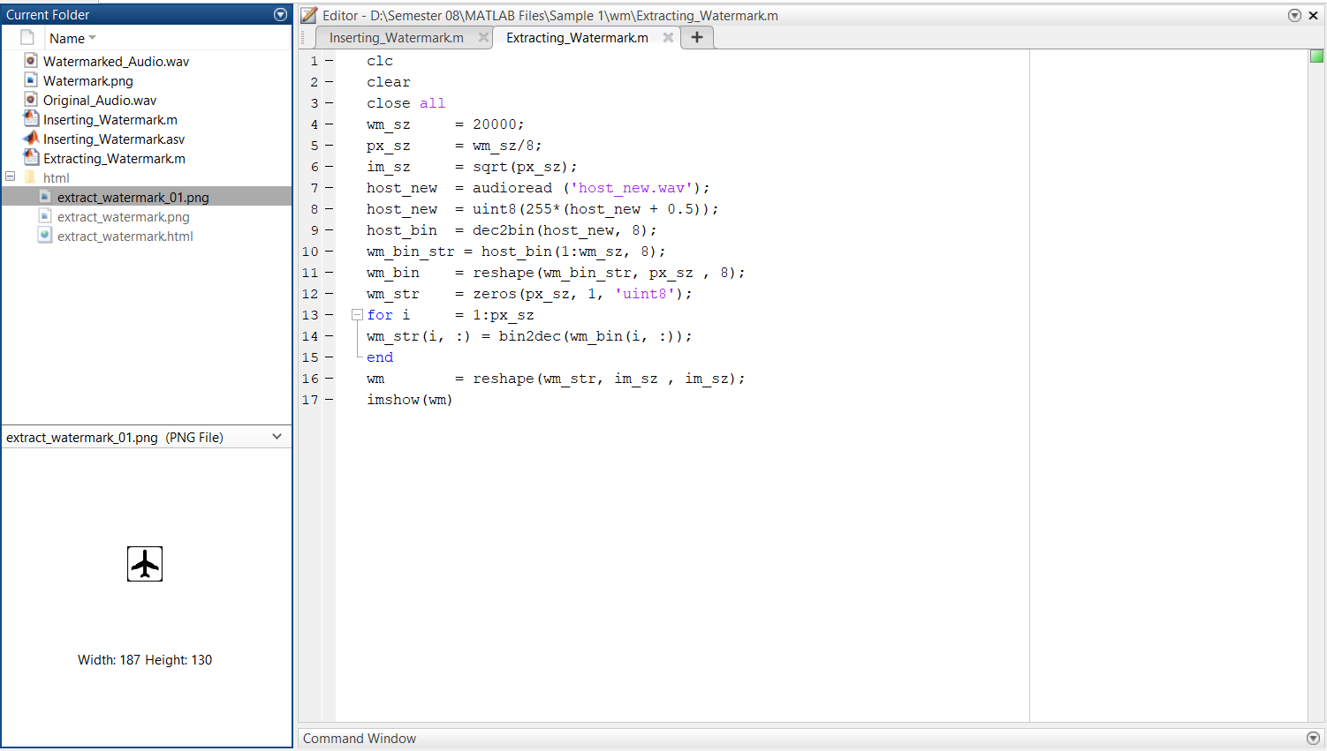

Code Snippet (Watermark Extraction)

Slide 18
Result
We then generated the traditionally encrypted audio signal and studied its pros and cons. We believe that encrypting an audio file like this has several advantages and disadvantages. But in the domain of encrypting an audio signal the disadvantages top the advantages. Some of the disadvantages are which are:
The original audio signal will be susceptible to noise.
Anyone with the audio file can easily see the tune used to encrypt the file and remove it using a mediocre level software.
The sender has almost no control over the encryption.
The raw audio signal gets quite messy to discern the original content of the file
Therefore after analyzing the previous outputs and studying their disadvantages we see that using digital watermarking of audio signals for enhanced signal protection is indeed one of the most convenient ways to go about the problem statement of audio encryption.
We drew the inference that using this form of audio encryption solves all the 4 disadvantages mentioned in the overlapping method of encryption. For starters not anyone who gets the encrypted audio can decode the audio as the sender has the numbers required to decrypt and extract the watermark.
Secondly the sender has total control over the encryption which was not possible in the traditional encryption methods. And lastly the integrity of the original audio signal stays preserved and does not get out of sync or phase, so if we want to send the audio file to a 3rd party we can do so with the watermarked audio intact.

Slide 19
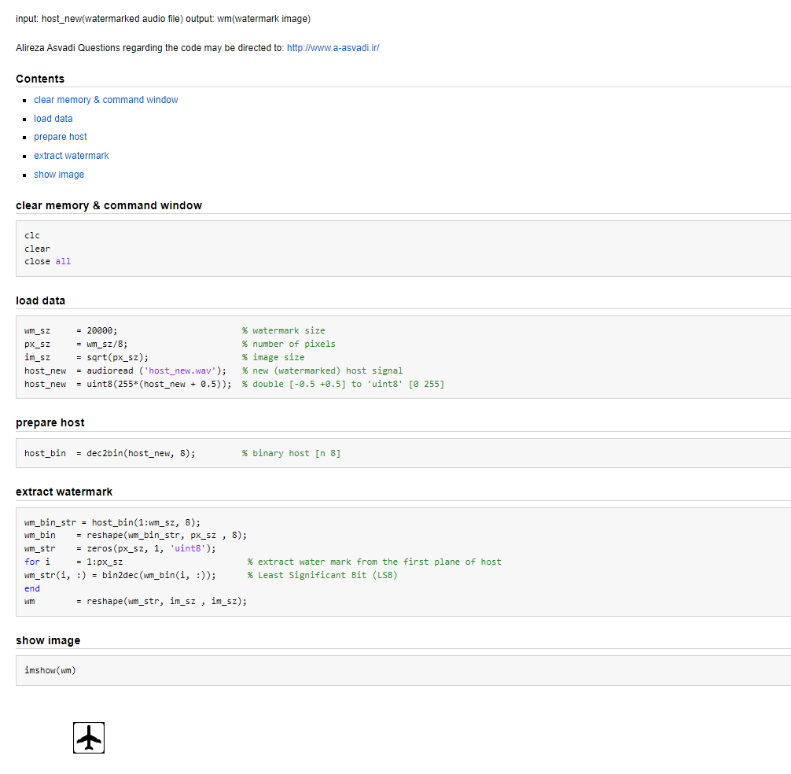
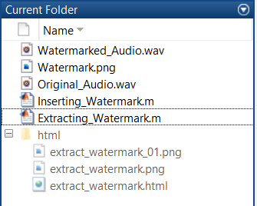
Hidden Encryption (Receiver Only)

Slide 20
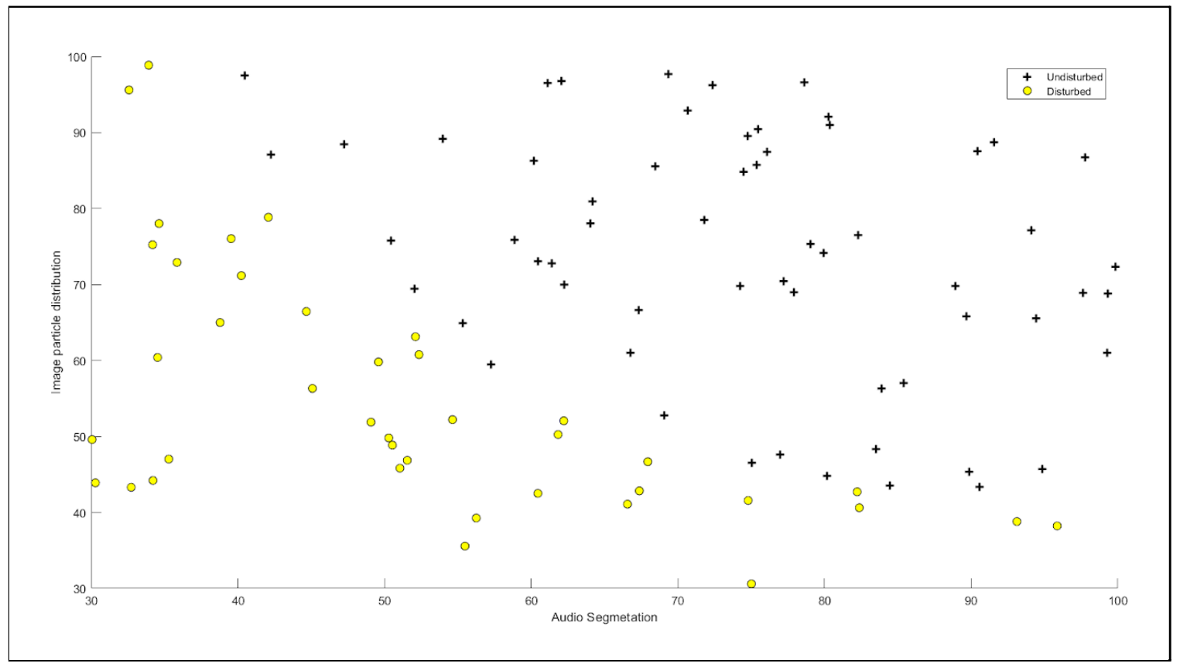

Slide 21
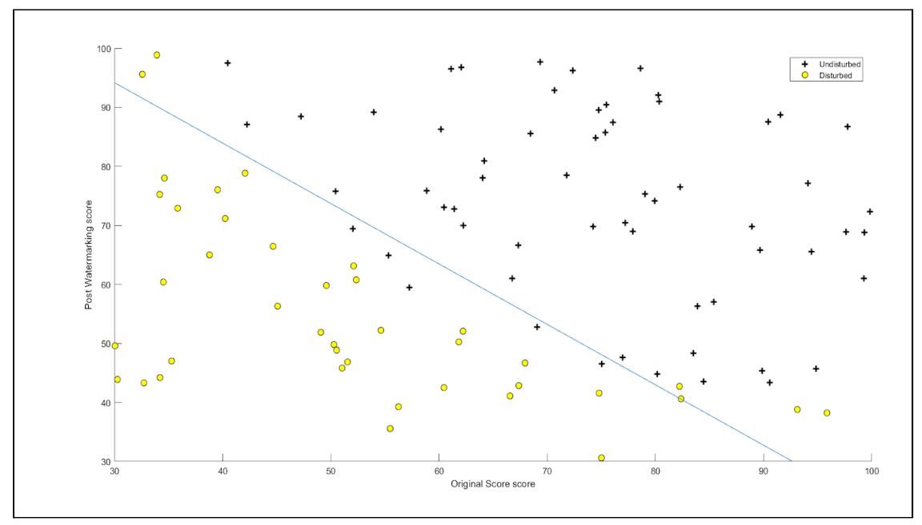

Slide 22
PARAMETER | EXPECTED | ACTUAL | TESTED ON
ISP Packet Loss | 212 / 228 Bytes 5 Seconds | 144 bytes (77% of expected) 10 seconds (282% better) | https://packetlosstest.com
Latency | Range = 80ms - 100ms | 87ms | https://superpowered.com/weblatency
Delay | Acceptable Delay: 24 Milliseconds | 20 milliseconds | https://packetlosstest.com
Distortion | Acceptable Delay: 7% | 6% | (No test available (needs manual monitoring)

Slide 23
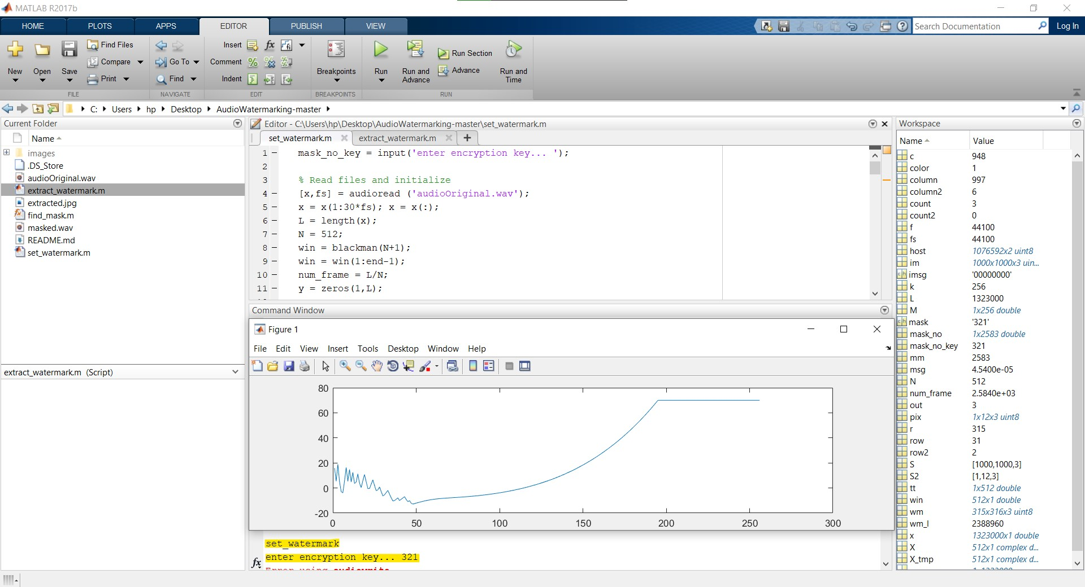
Corrections asked / Improvements made from 2nd review…

Slide 24
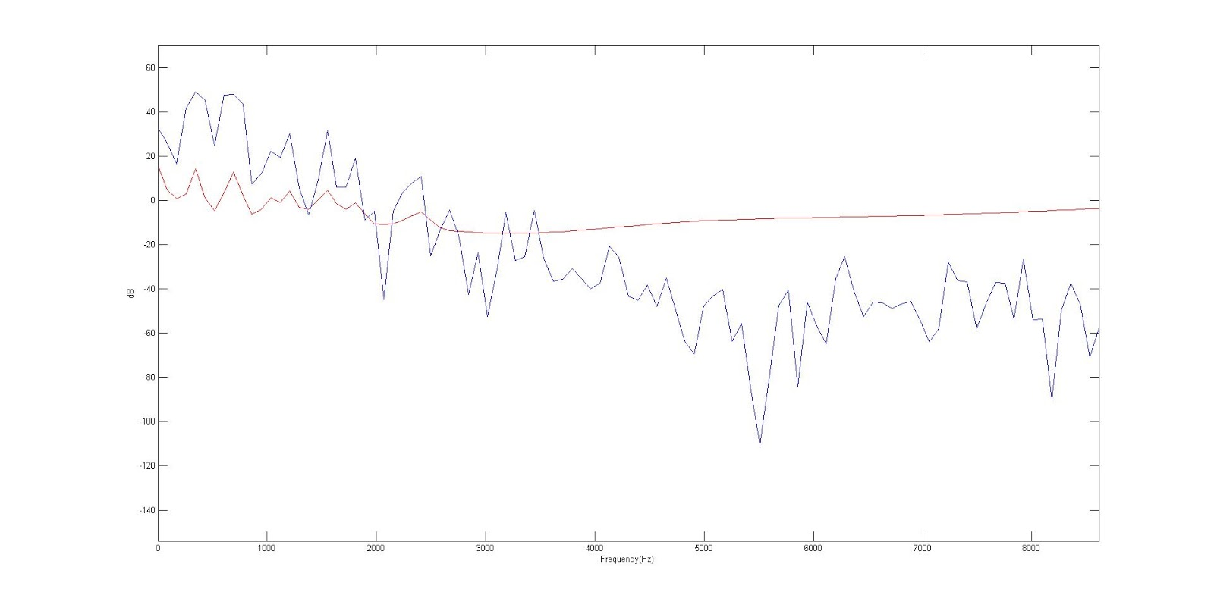
Corrections in 2nd review…

Slide 25
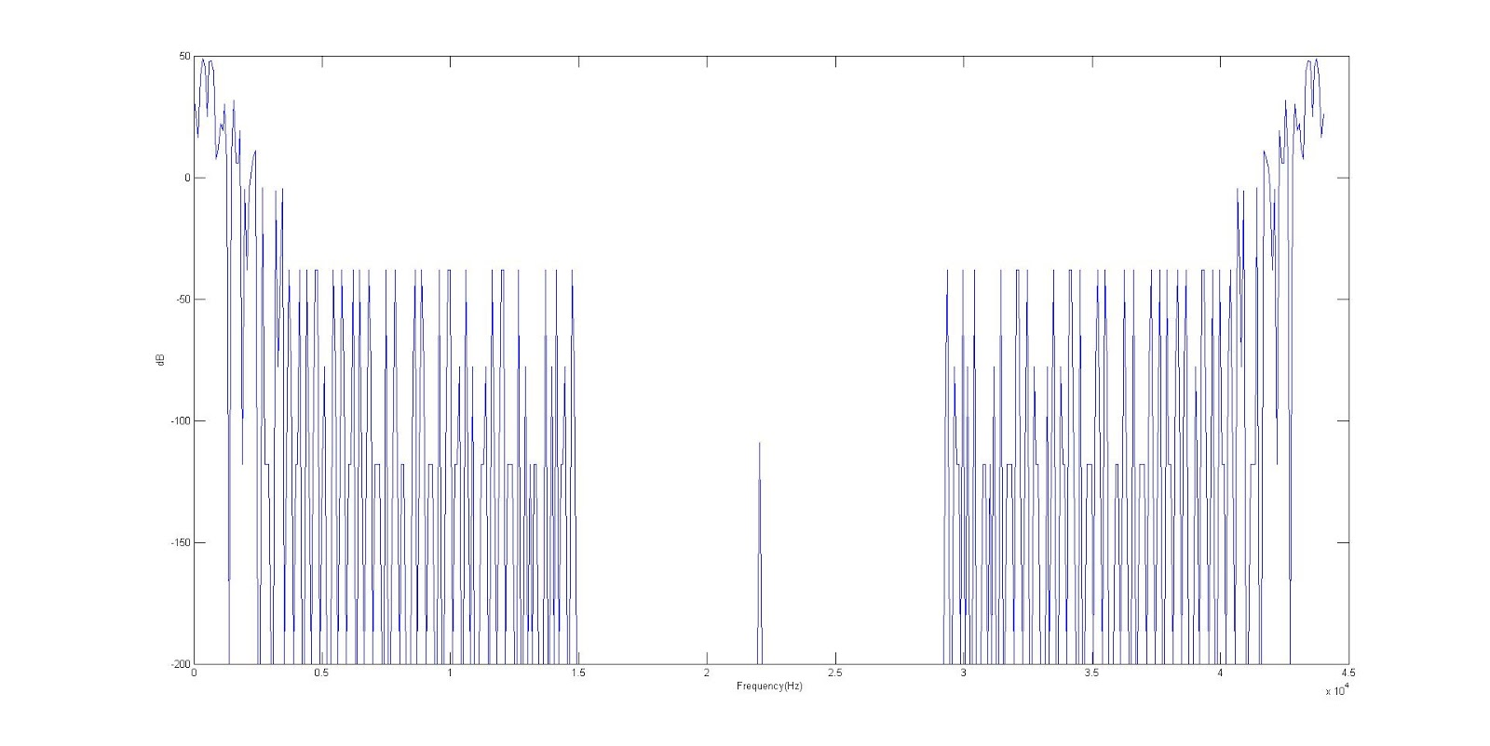

Slide 26
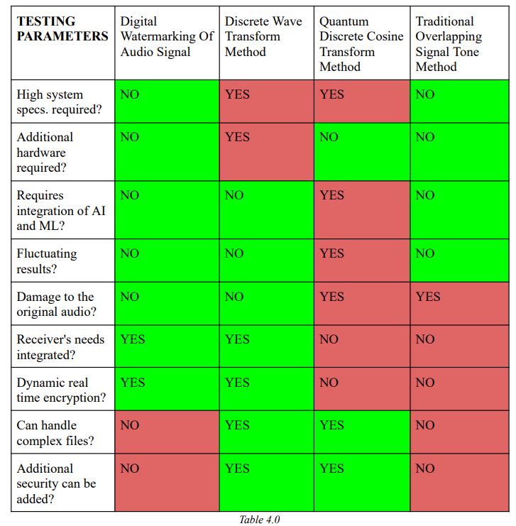
Result and Findings

Slide 27
S .No | Nature Of Work | Schedule | Status
1 | Literature Survey | January 2022 | Completed
2 | Identification of basic Facilities for project. |  | Completed
3 | Audio Classification | February 2022 | Completed
4 | Algorithmic Study |  | Completed
5 | QoS Analysis |  | Completed
6 | Digital Watermarking (Embedding and extraction) | March 2022 | Completed
7 | Testing/Validation Phase |  | Completed
8 | Result Enhancement and Fine Tuning |  | Completed

Slide 28
References
Pana, Flavius; Put, Ferdi (December 2014), "Performance evaluation of RSVP using OPNET Modeler", Simulation Modelling Practice and Theory, 49: 85–97,
IPSphere: Enabling Advanced Service Delivery Archived January 13, 2011, at the Wayback Machine
"End-to-end quality of service support over heterogeneous networks". Project description. European Community Research and Development Information Service. Retrieved October 12, 2011.
Torsten Braun; Thomas Staub (2008). End-to-end quality of service over heterogeneous networks. Springer. ISBN 978-3-540-79119-5.
"Multi Service Access Everywhere (MUSE)". Project website. Retrieved October 12, 2011.
"Multi Service Access Everywhere". Project description. European Community Research and Development Information Service. Retrieved October 12, 2011.
M. Davarynejad, S. Sedghi, M. Bahrepour, C.W. Ahn, M. Akbarzadeh, C. A. Coello Coello, "Detecting Hidden Information from Watermarked Signal using Granulation Based Fitness Approximation", Applications of Soft Computing: From Theory to Praxis, Springer, Series: Advances in Intelligent and Soft Computing, Volume 58/2009, ISBN 463–472, 2009.
M. Davarynejad, C.W. Ahn, J. Vrancken, J. van den Berg, C .A. Coello Coello, "Evolutionary hidden information detection by granulation-based fitness approximation", Applied Soft Computing, Vol. 10(3), pp. 719–729, 2010.

